Slide 1
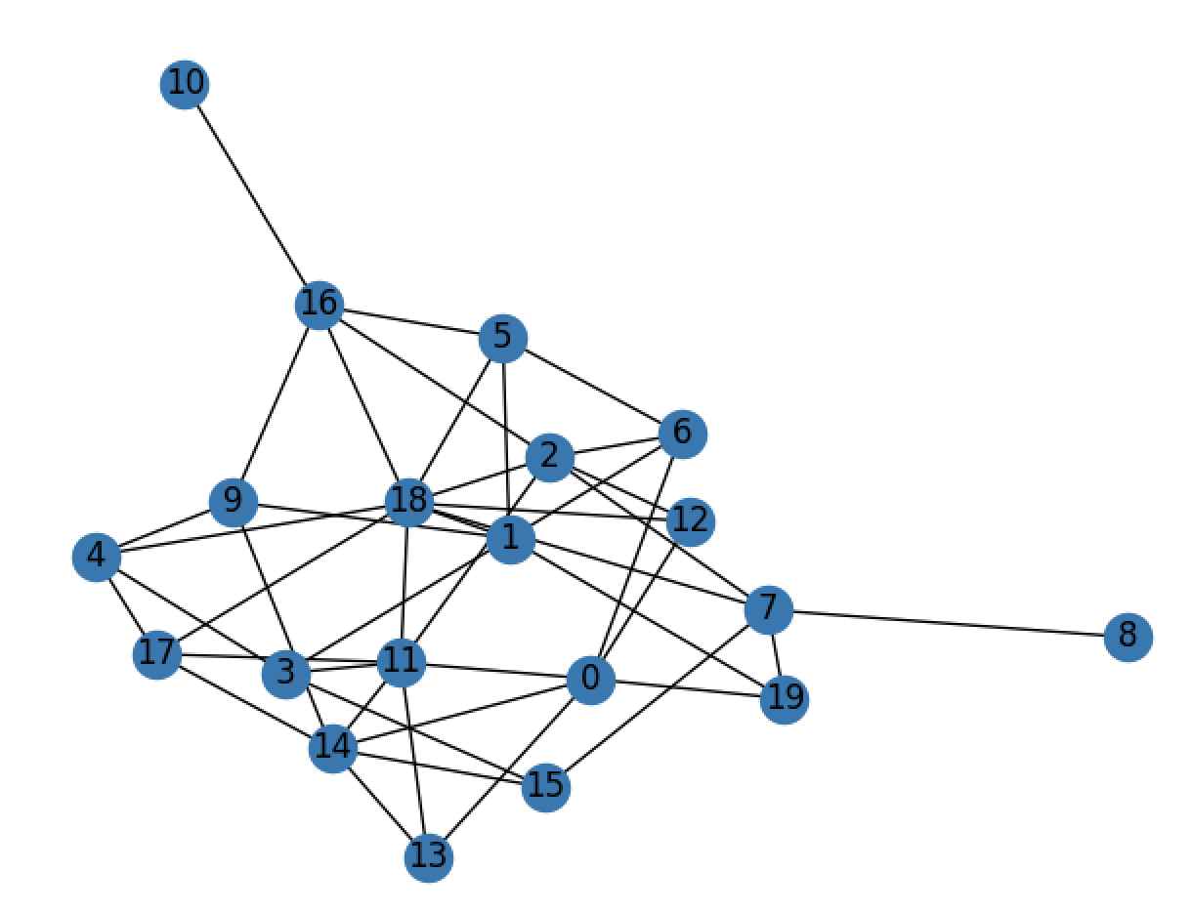
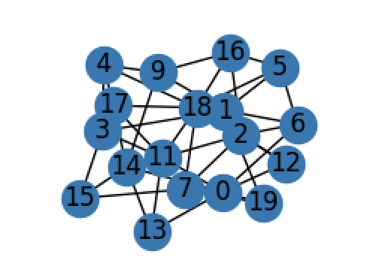
Topology
#node: 20
#edges 44
#node: 18
#edges 42
M2
M1
Before trim
After trim

Slide 2
Topology
Edge delay mean [1, 10]: [1,100]
[3, 6, 7, 2, 9, 8, 8, 9, 8, 3, 2, 8, 5, 3, 9, 9, 3, 2, 8, 5, 4, 6, 3, 4, 1, 4, 7, 7, 5, 7, 7, 6, 6, 3, 5, 4, 3, 9, 3, 7, 3, 6, 2, 8]
M2
Sample size from the exponential distribution:
3000
M1
Total path number from M1 to M2: 74

Slide 3
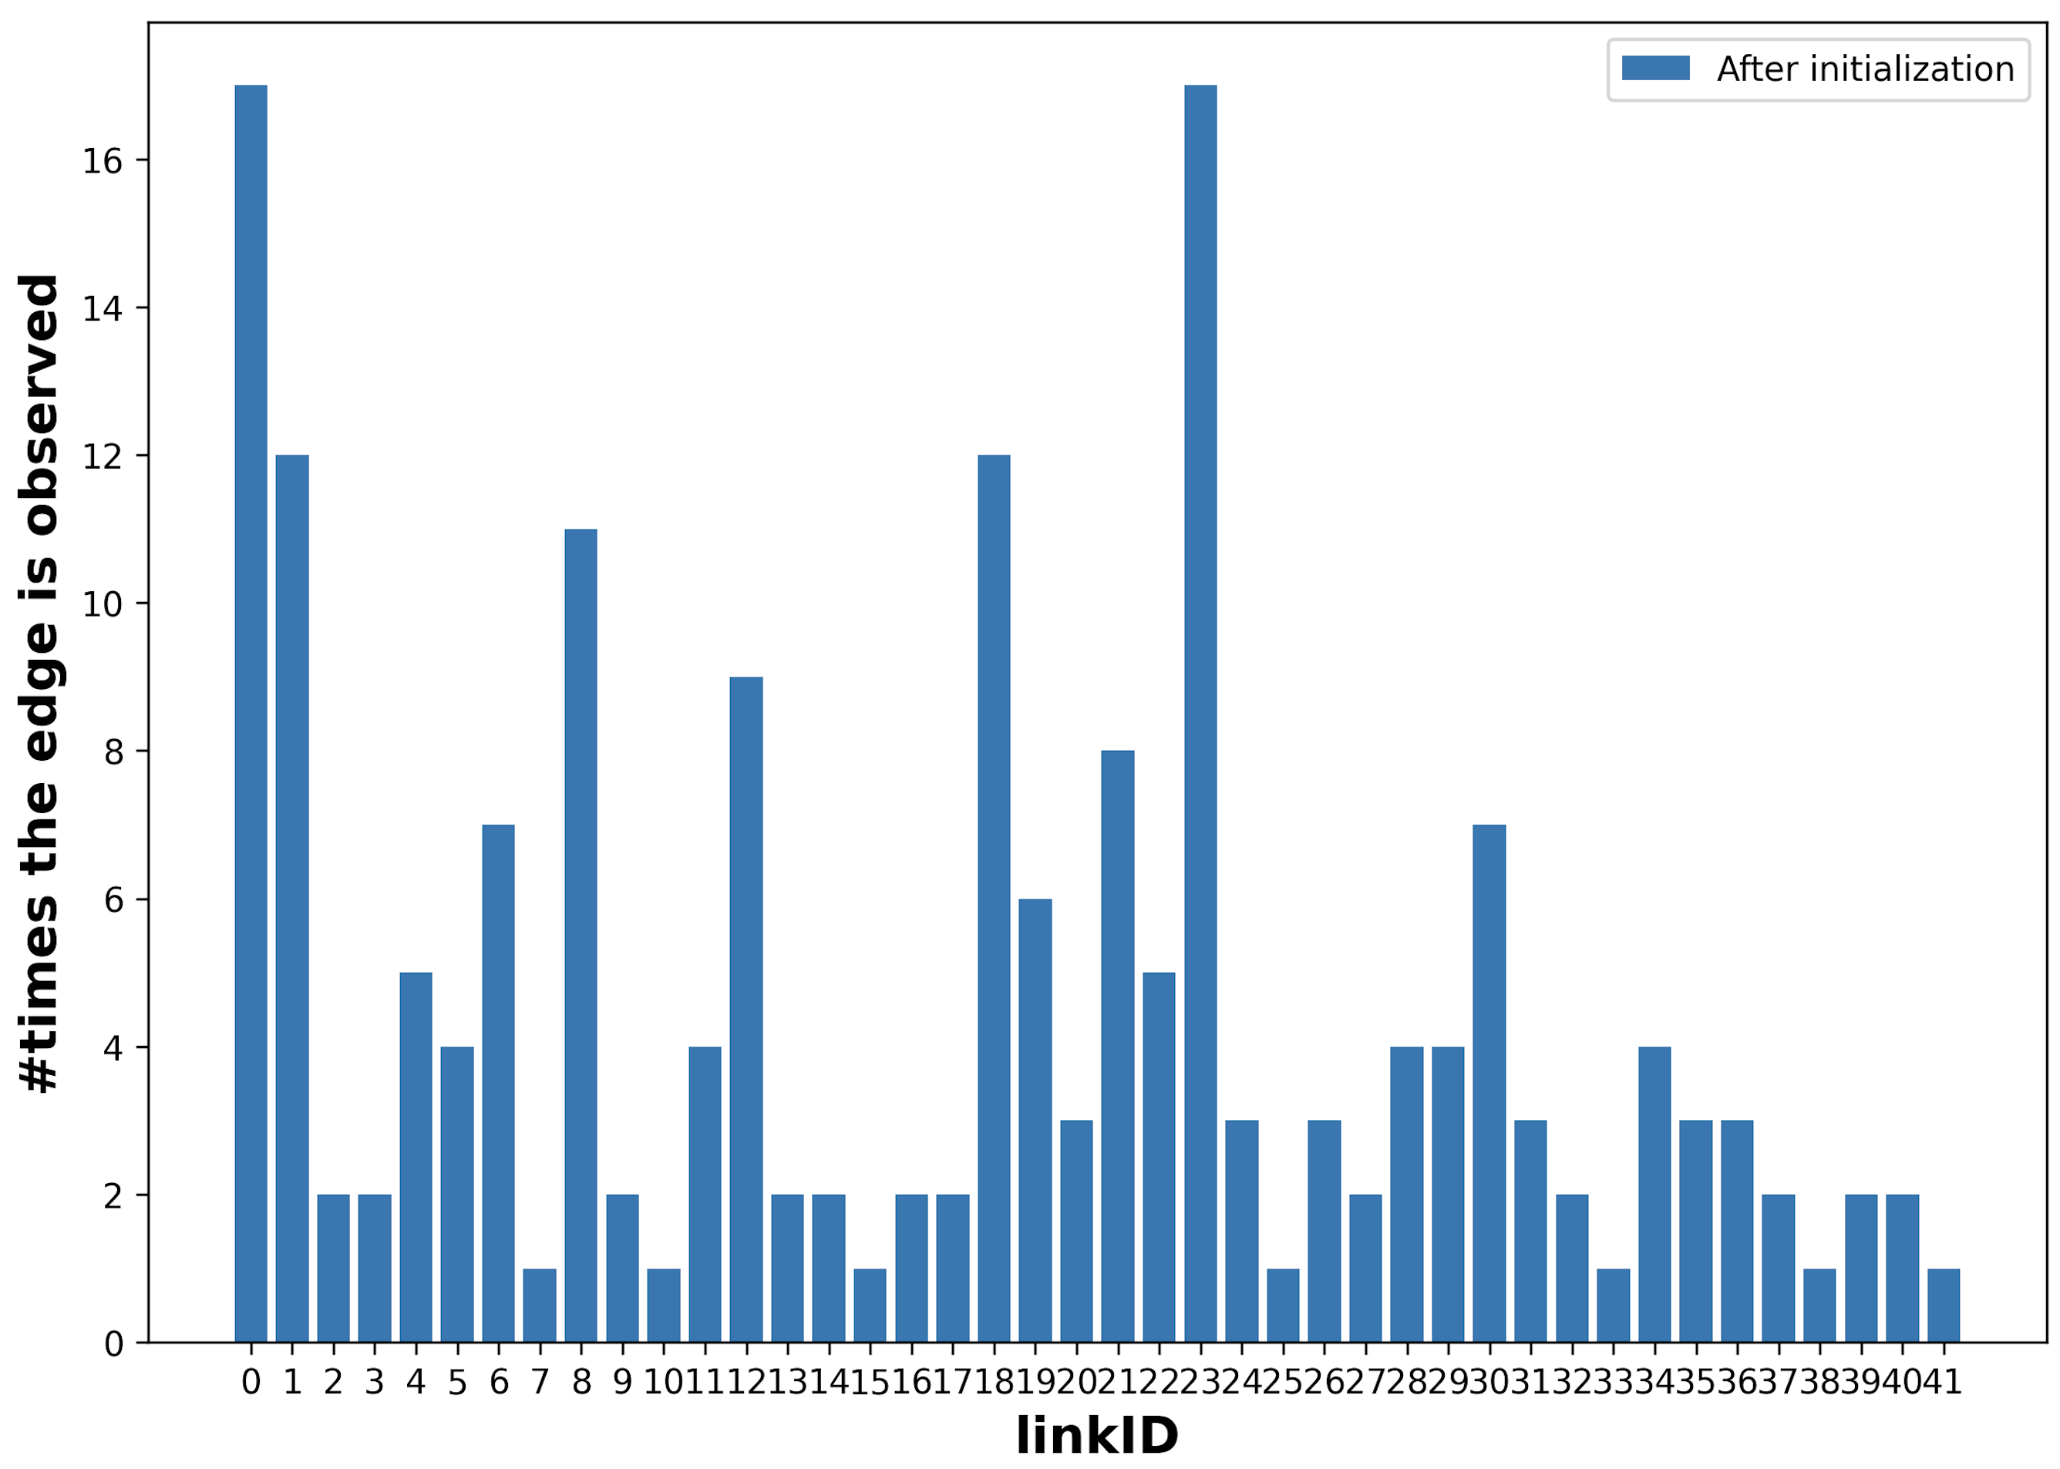
Initialization:
for each edge e in G.edges:
find a path p so that e in p
update MAB variables Dict_edge_theta[edge], Dict_edge_m[edge]

Slide 4
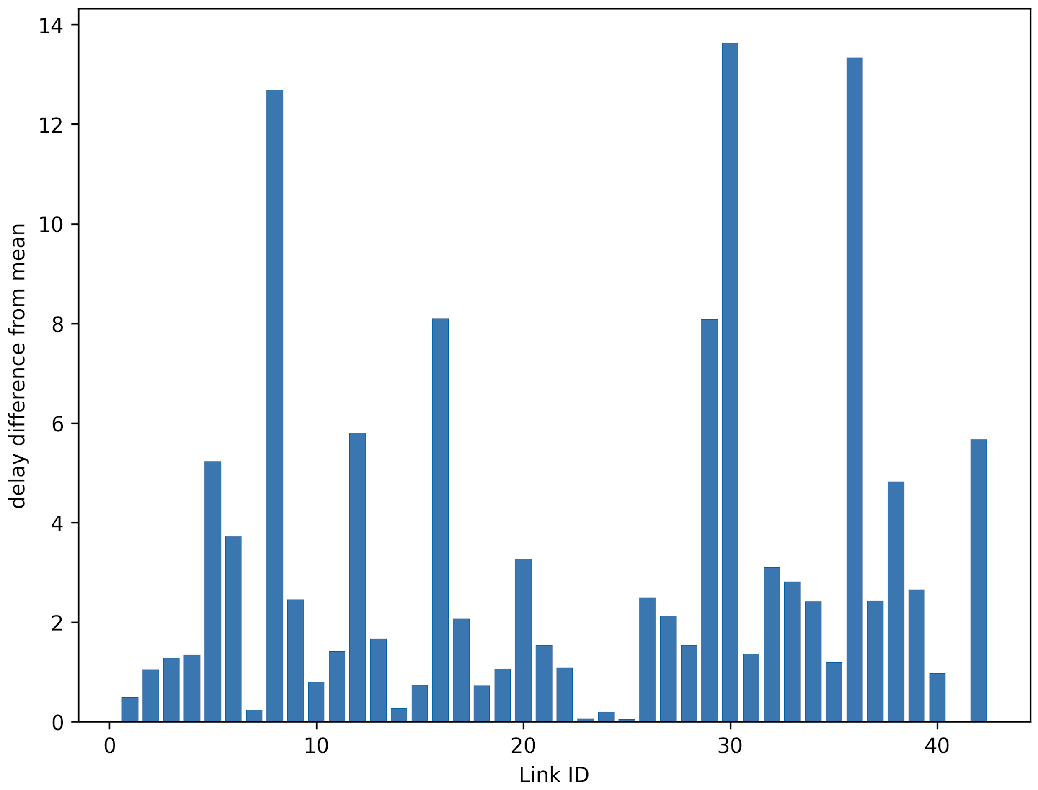
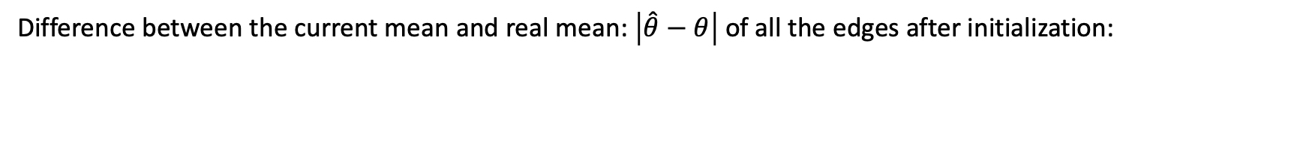
Initialization:
Difference between the current mean and real mean: $\left|\hat{θ}−θ\right|$of all the edges after initialization:

Slide 5
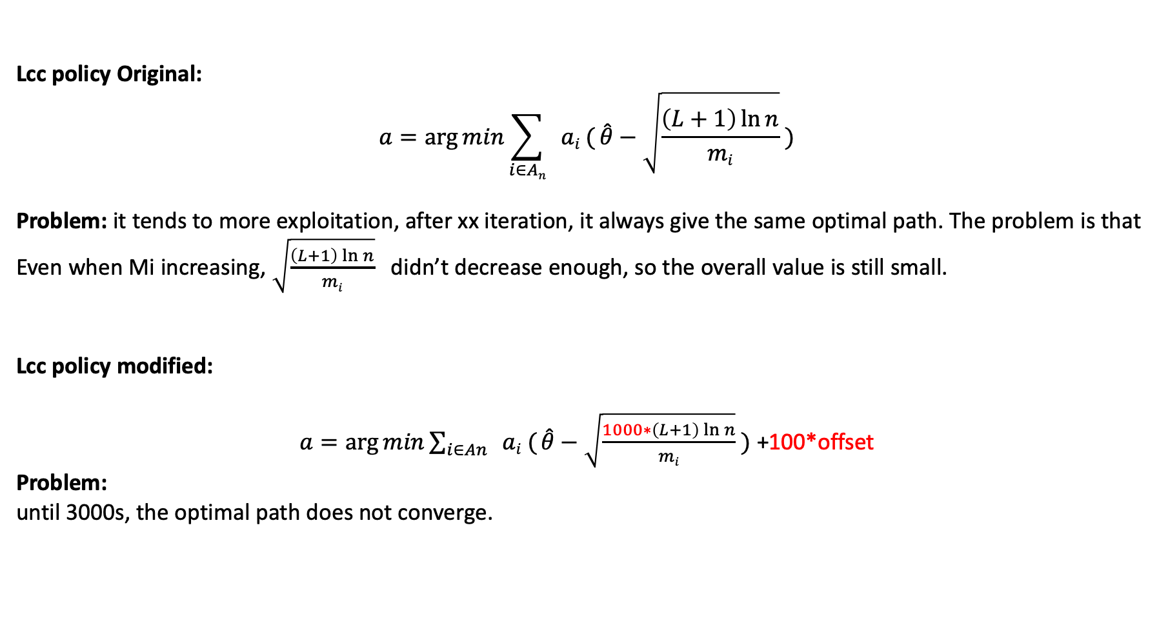
Train with Multi-armed-bandits algorithm:
Lcc policy Original:
$$a=\arg{min\sum_{i∈An}{ ai ( \hat{θ}−\sqrt{\frac{\left(L+1\right)\ln{n}}{mi}}}} )$$
Problem: it tends to more exploitation, after xx iteration, it always give the same optimal path. The problem is that
Even when Mi increasing, $\sqrt{\frac{\left(L+1\right)\ln{n}}{mi}}$ didn’t decrease enough, so the overall value is still small.
Lcc policy modified:
$a=\arg{min\sum_{i∈An}{ ai ( \hat{θ}−\sqrt{\frac{1000∗\left(L+1\right)\ln{n}}{mi}}}} )$ +100*offset
Problem:
until 3000s, the optimal path does not converge.

Slide 6
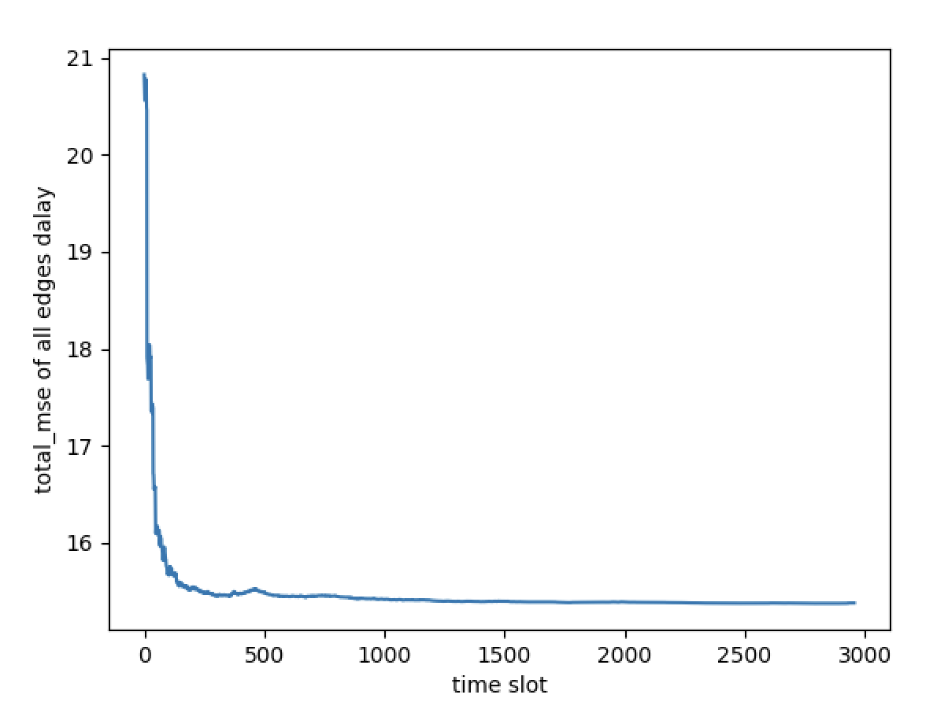
Overall edge delay mean square error (MSE) along the time

Slide 7
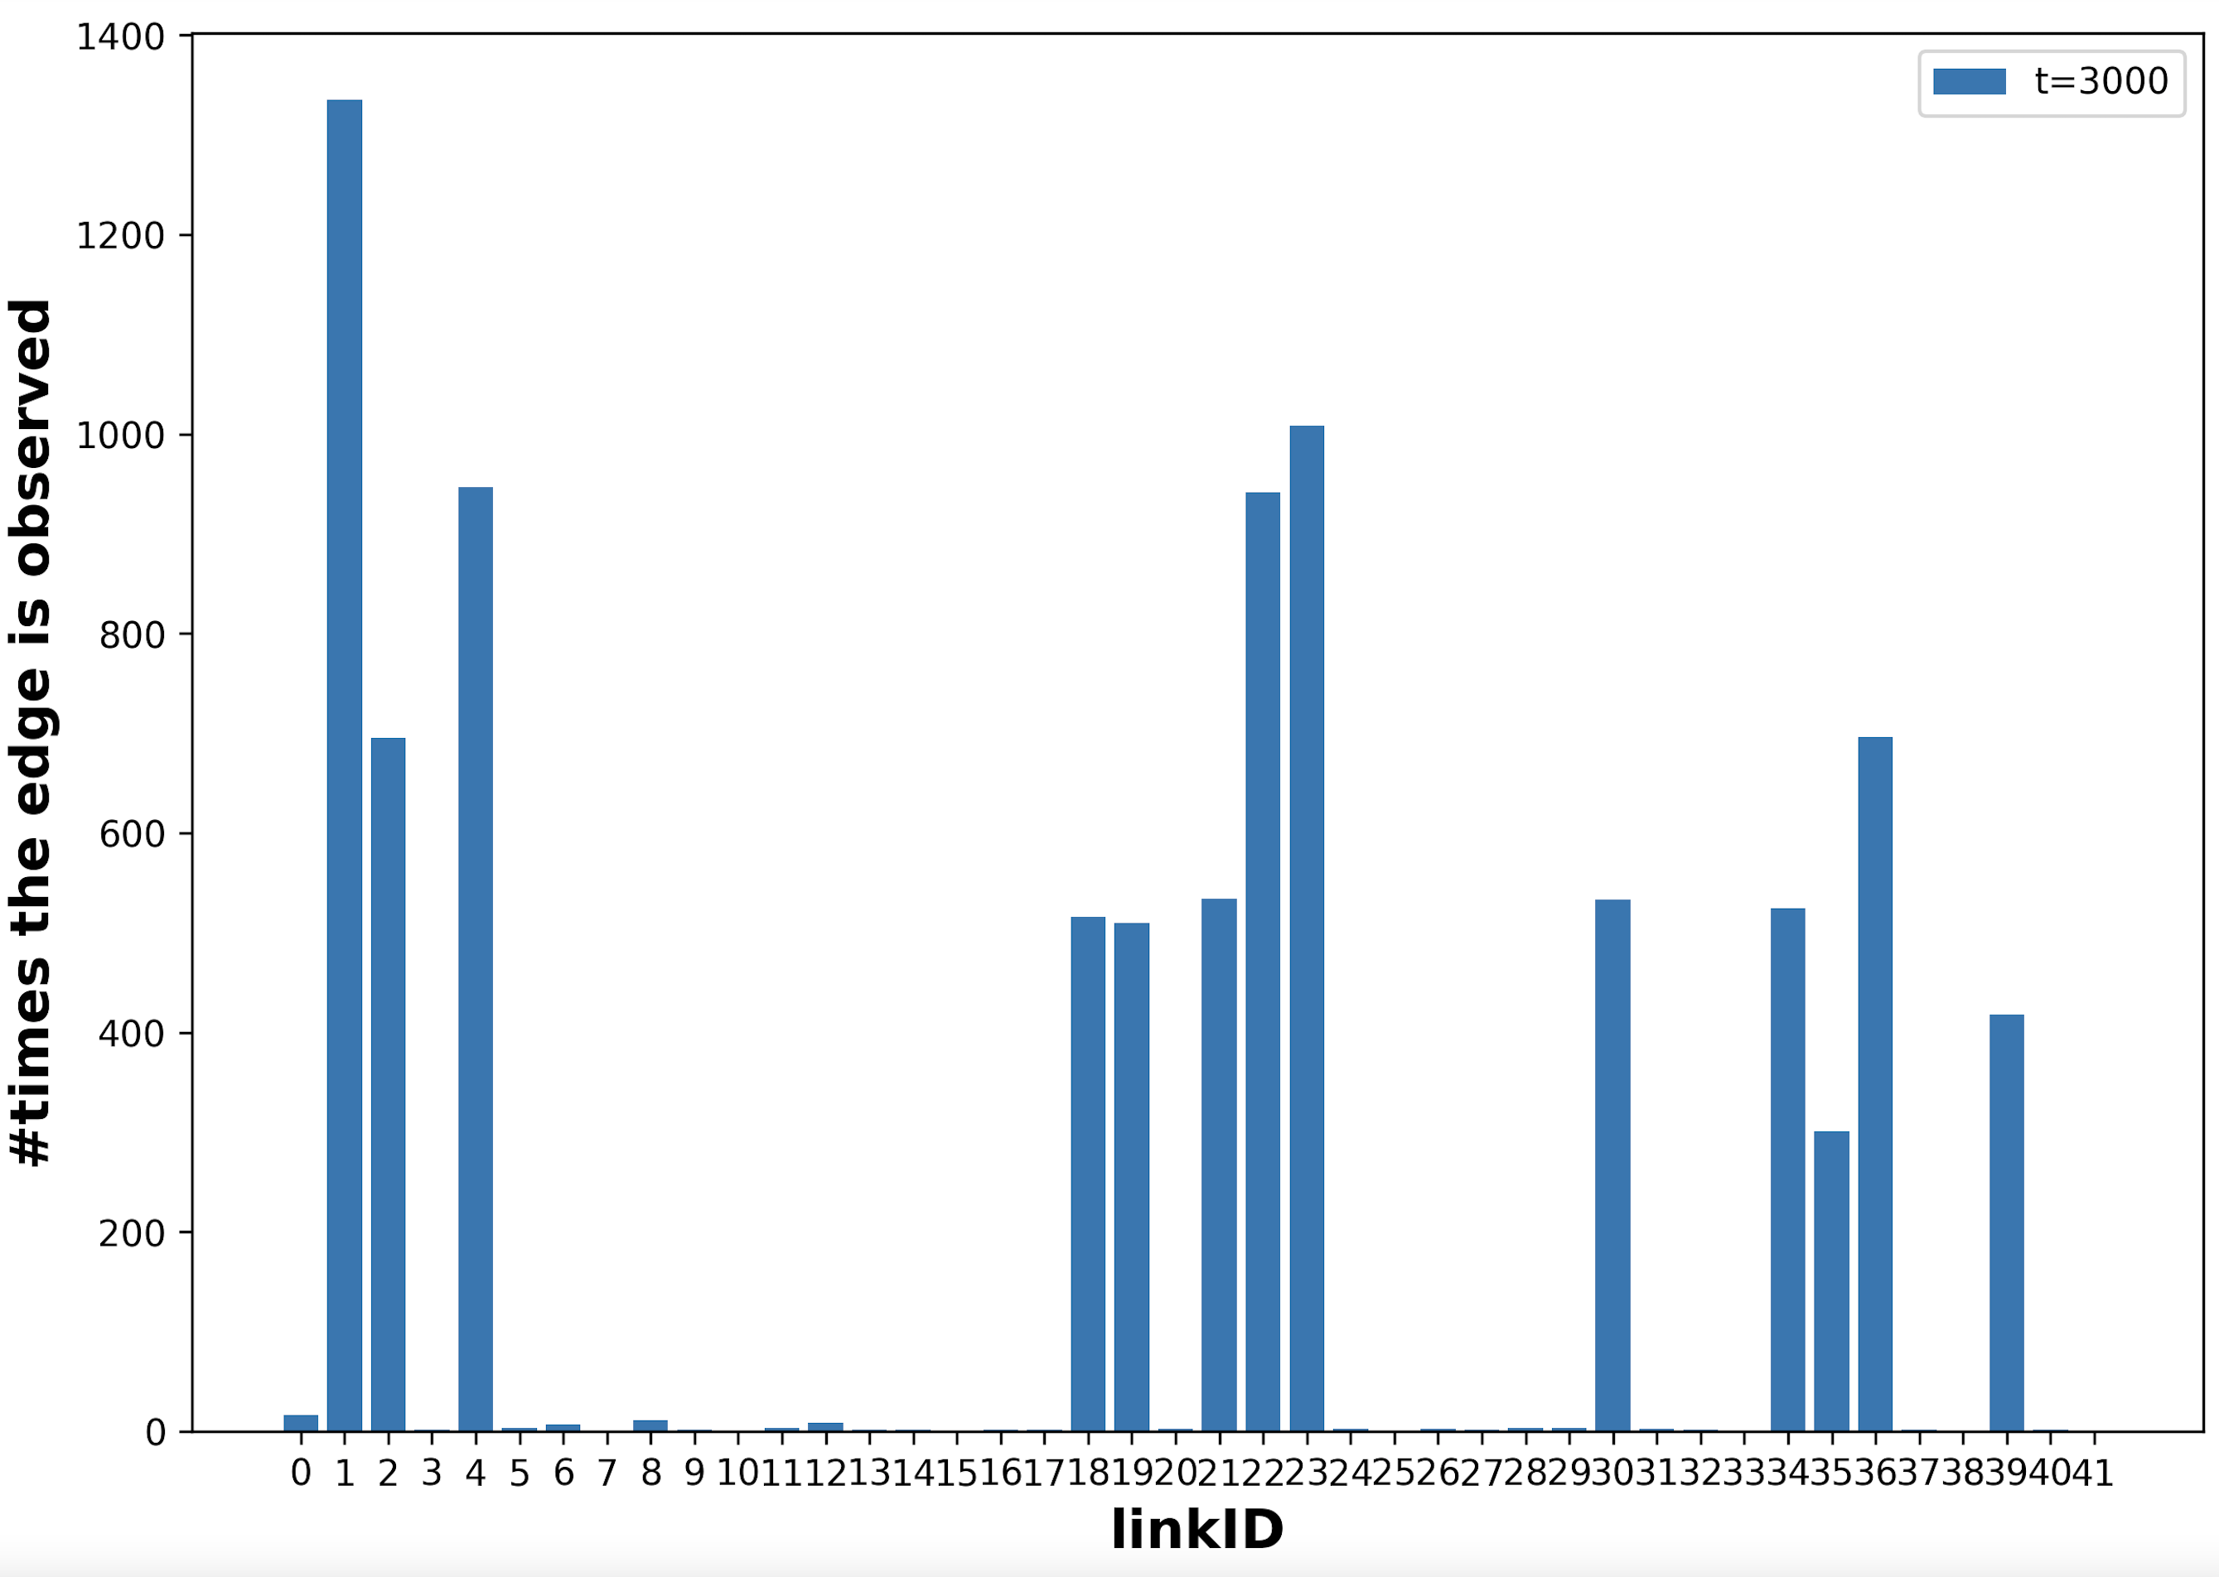
# of Edge get explored - 13 edges has been extremely explored with 2 monitors

Slide 8
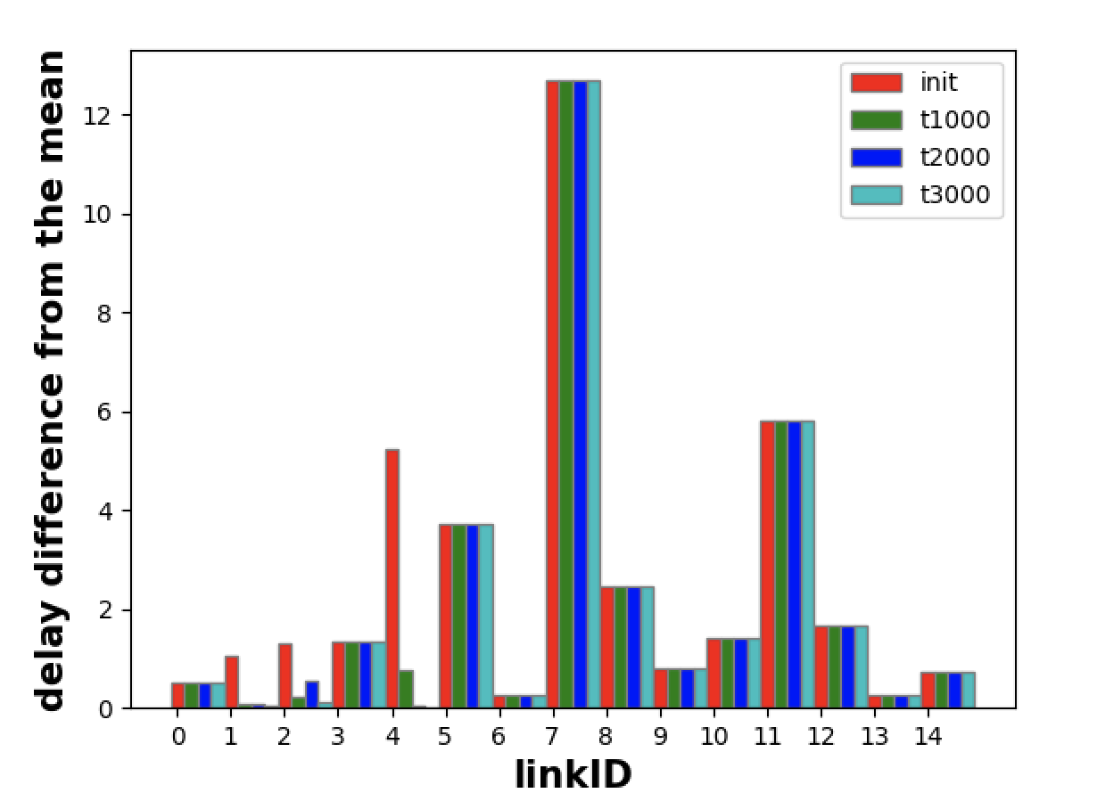
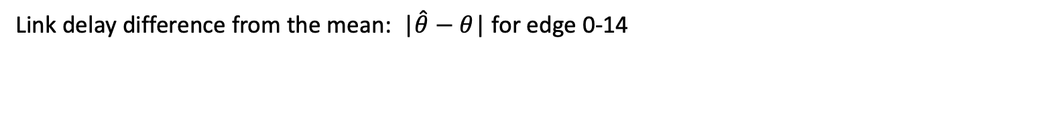
Link delay difference from the mean: |$\hat{θ}−θ$| for edge 0-14

Slide 9
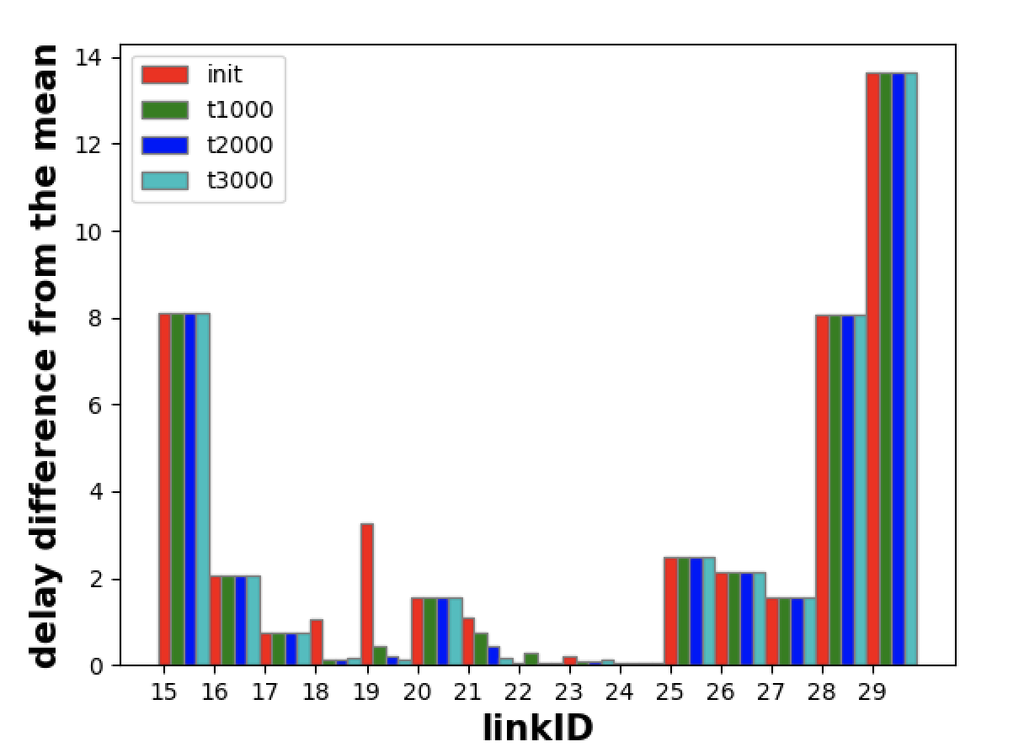
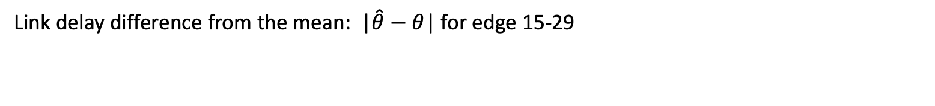
Link delay difference from the mean: |$\hat{θ}−θ$| for edge 15-29

Slide 10
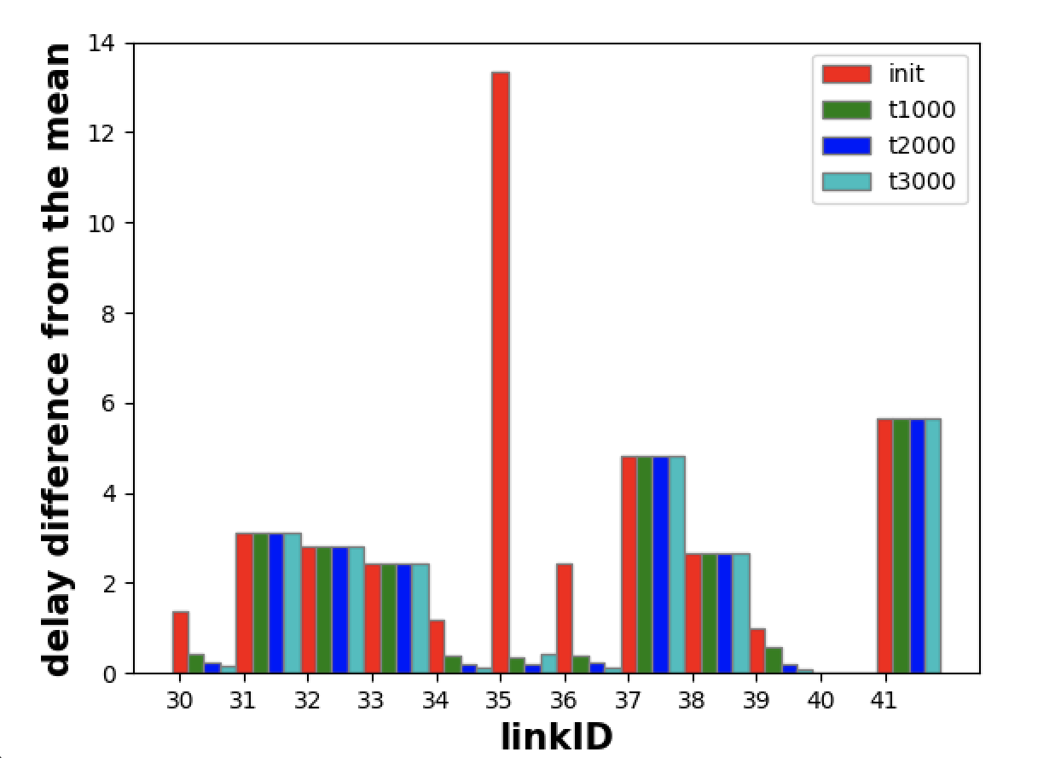
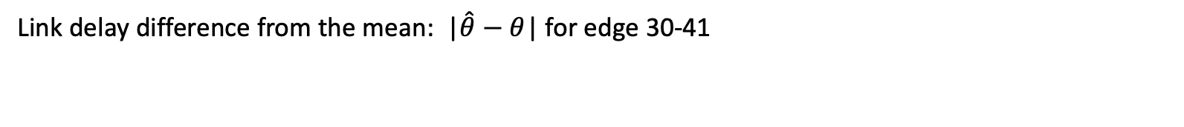
Link delay difference from the mean: |$\hat{θ}−θ$| for edge 30-41

Slide 11
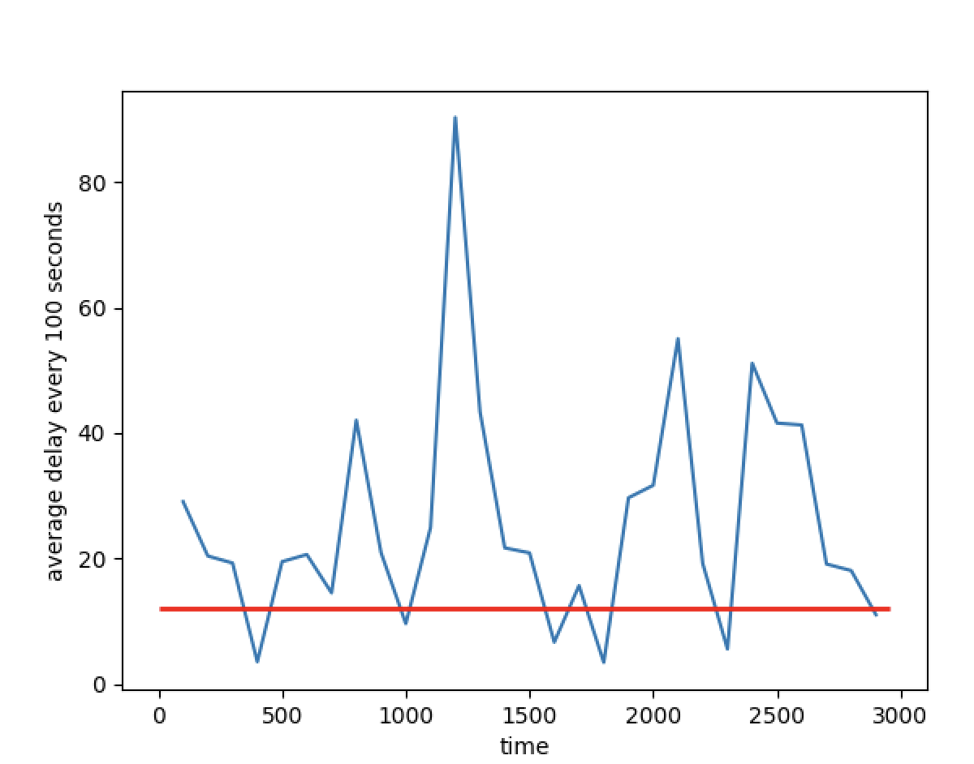
The delay of the optimal path given by the model

Slide 12
Total path between these two monitors:
There are 74 paths between the two monitors.
But, during the training, only 6 paths are explored, 13 edges has been explored in total.
{'0-14-17-4': 416,
'0-12-18-4': 693,
'0-11-17-4': 521,
'0-14-9-4': 526,
'0-11-18-4': 298,
'0-11-3-4': 504}

Slide 13
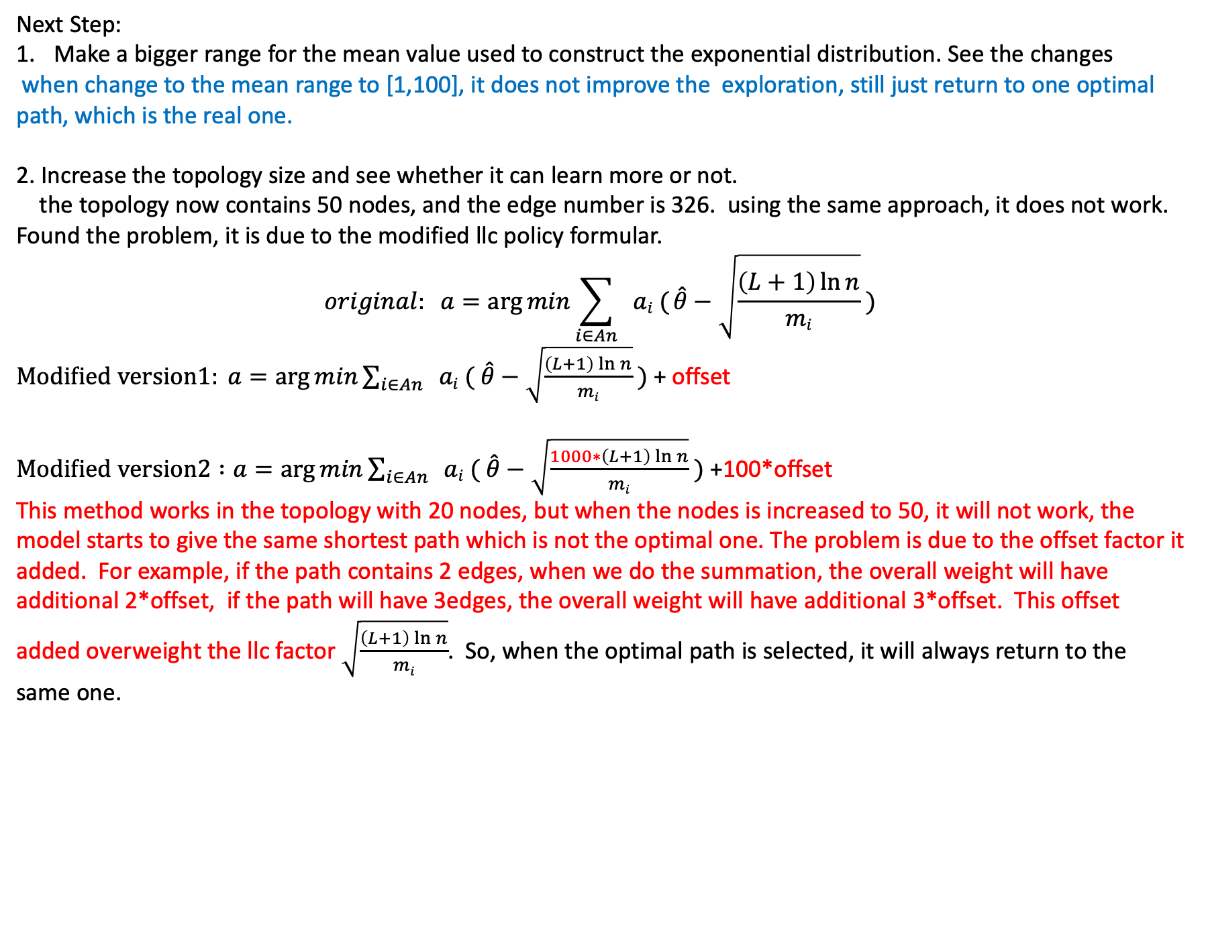
Next Step:
Make a bigger range for the mean value used to construct the exponential distribution. See the changes
when change to the mean range to [1,100], it does not improve the exploration, still just return to one optimal path, which is the real one.
2. Increase the topology size and see whether it can learn more or not.
the topology now contains 50 nodes, and the edge number is 326. using the same approach, it does not work. Found the problem, it is due to the modified llc policy formular.
$$original: a=\arg{min\sum_{i∈An}{ ai ( \hat{θ}−\sqrt{\frac{\left(L+1\right)\ln{n}}{mi}}}} )$$
$Modified version1: a=\arg{min\sum_{i∈An}{ ai ( \hat{θ}−\sqrt{\frac{\left(L+1\right)\ln{n}}{mi}}}} )$ + offset
$Modified version2 :a=\arg{min\sum_{i∈An}{ ai ( \hat{θ}−\sqrt{\frac{1000∗\left(L+1\right)\ln{n}}{mi}}}} )$ +100*offset
This method works in the topology with 20 nodes, but when the nodes is increased to 50, it will not work, the model starts to give the same shortest path which is not the optimal one. The problem is due to the offset factor it added. For example, if the path contains 2 edges, when we do the summation, the overall weight will have additional 2*offset, if the path will have 3edges, the overall weight will have additional 3*offset. This offset added overweight the llc factor $\sqrt{\frac{\left(L+1\right)\ln{n}}{mi}}$. So, when the optimal path is selected, it will always return to the same one.

Slide 14
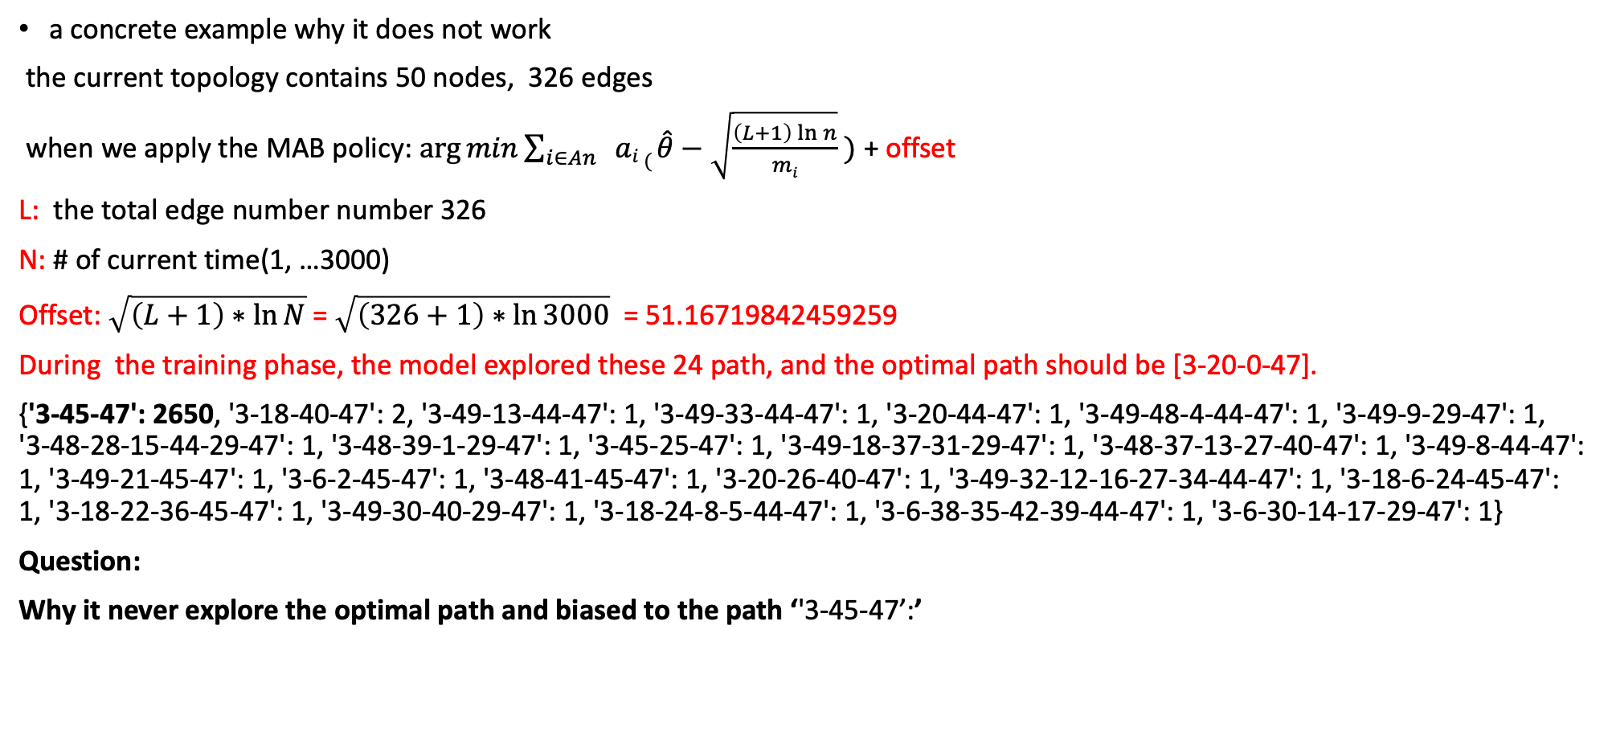
a concrete example why it does not work
the current topology contains 50 nodes, 326 edges
when we apply the MAB policy: $\arg{min\sum_{i∈An}{ ai ( \hat{θ}−\sqrt{\frac{\left(L+1\right)\ln{n}}{mi}}}} )$ + offset
L: the total edge number number 326
N: # of current time(1, …3000)
Offset: $\sqrt{\left(L+1\right)∗\ln{N}}$ = $\sqrt{\left(326+1\right)∗\ln{3000}}$ = 51.16719842459259
During the training phase, the model explored these 24 path, and the optimal path should be [3-20-0-47].
{'3-45-47': 2650, '3-18-40-47': 2, '3-49-13-44-47': 1, '3-49-33-44-47': 1, '3-20-44-47': 1, '3-49-48-4-44-47': 1, '3-49-9-29-47': 1, '3-48-28-15-44-29-47': 1, '3-48-39-1-29-47': 1, '3-45-25-47': 1, '3-49-18-37-31-29-47': 1, '3-48-37-13-27-40-47': 1, '3-49-8-44-47': 1, '3-49-21-45-47': 1, '3-6-2-45-47': 1, '3-48-41-45-47': 1, '3-20-26-40-47': 1, '3-49-32-12-16-27-34-44-47': 1, '3-18-6-24-45-47': 1, '3-18-22-36-45-47': 1, '3-49-30-40-29-47': 1, '3-18-24-8-5-44-47': 1, '3-6-38-35-42-39-44-47': 1, '3-6-30-14-17-29-47': 1}
Question:
Why it never explore the optimal path and biased to the path ‘'3-45-47’:’

Slide 15
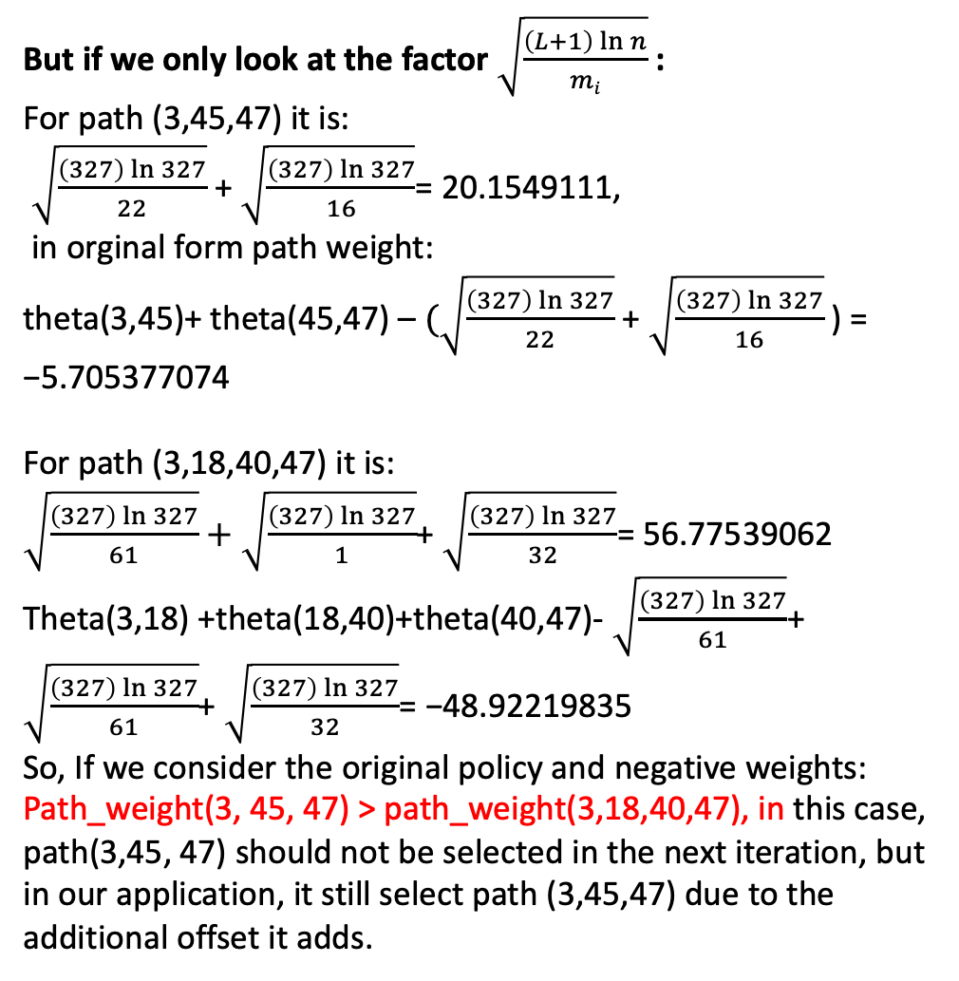
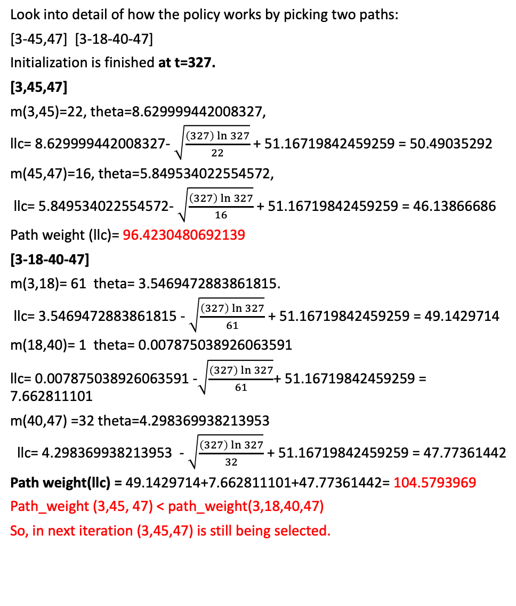
But if we only look at the factor $\sqrt{\frac{\left(L+1\right)\ln{n}}{mi}}$ :
For path (3,45,47) it is:
$\sqrt{\frac{\left(327\right)\ln{327}}{22}}$ + $\sqrt{\frac{\left(327\right)\ln{327}}{16}}$= 20.1549111,
in orginal form path weight:
theta(3,45)+ theta(45,47) – $(\sqrt{\frac{\left(327\right)\ln{327}}{22}}$ + $\sqrt{\frac{\left(327\right)\ln{327}}{16}}$) = −5.705377074
For path (3,18,40,47) it is:
$\sqrt{\frac{\left(327\right)\ln{327}}{61}}+$ $\sqrt{\frac{\left(327\right)\ln{327}}{1}}$+ $\sqrt{\frac{\left(327\right)\ln{327}}{32}}$= 56.77539062
Theta(3,18) +theta(18,40)+theta(40,47)- $\sqrt{\frac{\left(327\right)\ln{327}}{61}}$+ $\sqrt{\frac{\left(327\right)\ln{327}}{61}}$+ $\sqrt{\frac{\left(327\right)\ln{327}}{32}}$= −48.92219835
So, If we consider the original policy and negative weights:
Path_weight(3, 45, 47) > path_weight(3,18,40,47), in this case, path(3,45, 47) should not be selected in the next iteration, but in our application, it still select path (3,45,47) due to the additional offset it adds.
Look into detail of how the policy works by picking two paths:
[3-45,47] [3-18-40-47]
Initialization is finished at t=327.
[3,45,47]
m(3,45)=22, theta=8.629999442008327,
llc= 8.629999442008327- $\sqrt{\frac{\left(327\right)\ln{327}}{22}}$ + 51.16719842459259 = 50.49035292
m(45,47)=16, theta=5.849534022554572,
llc= 5.849534022554572- $\sqrt{\frac{\left(327\right)\ln{327}}{16}}$ + 51.16719842459259 = 46.13866686
Path weight (llc)= 96.4230480692139
[3-18-40-47]
m(3,18)= 61 theta= 3.5469472883861815.
llc= 3.5469472883861815 - $\sqrt{\frac{\left(327\right)\ln{327}}{61}}$ + 51.16719842459259 = 49.1429714
m(18,40)= 1 theta= 0.007875038926063591
llc= 0.007875038926063591 -$\sqrt{\frac{\left(327\right)\ln{327}}{61}}$+ 51.16719842459259 = 7.662811101
m(40,47) =32 theta=4.298369938213953
llc= 4.298369938213953 - $\sqrt{\frac{\left(327\right)\ln{327}}{32}}$ + 51.16719842459259 = 47.77361442
Path weight(llc) = 49.1429714+7.662811101+47.77361442= 104.5793969
Path_weight (3,45, 47) < path_weight(3,18,40,47)
So, in next iteration (3,45,47) is still being selected.

Slide 16
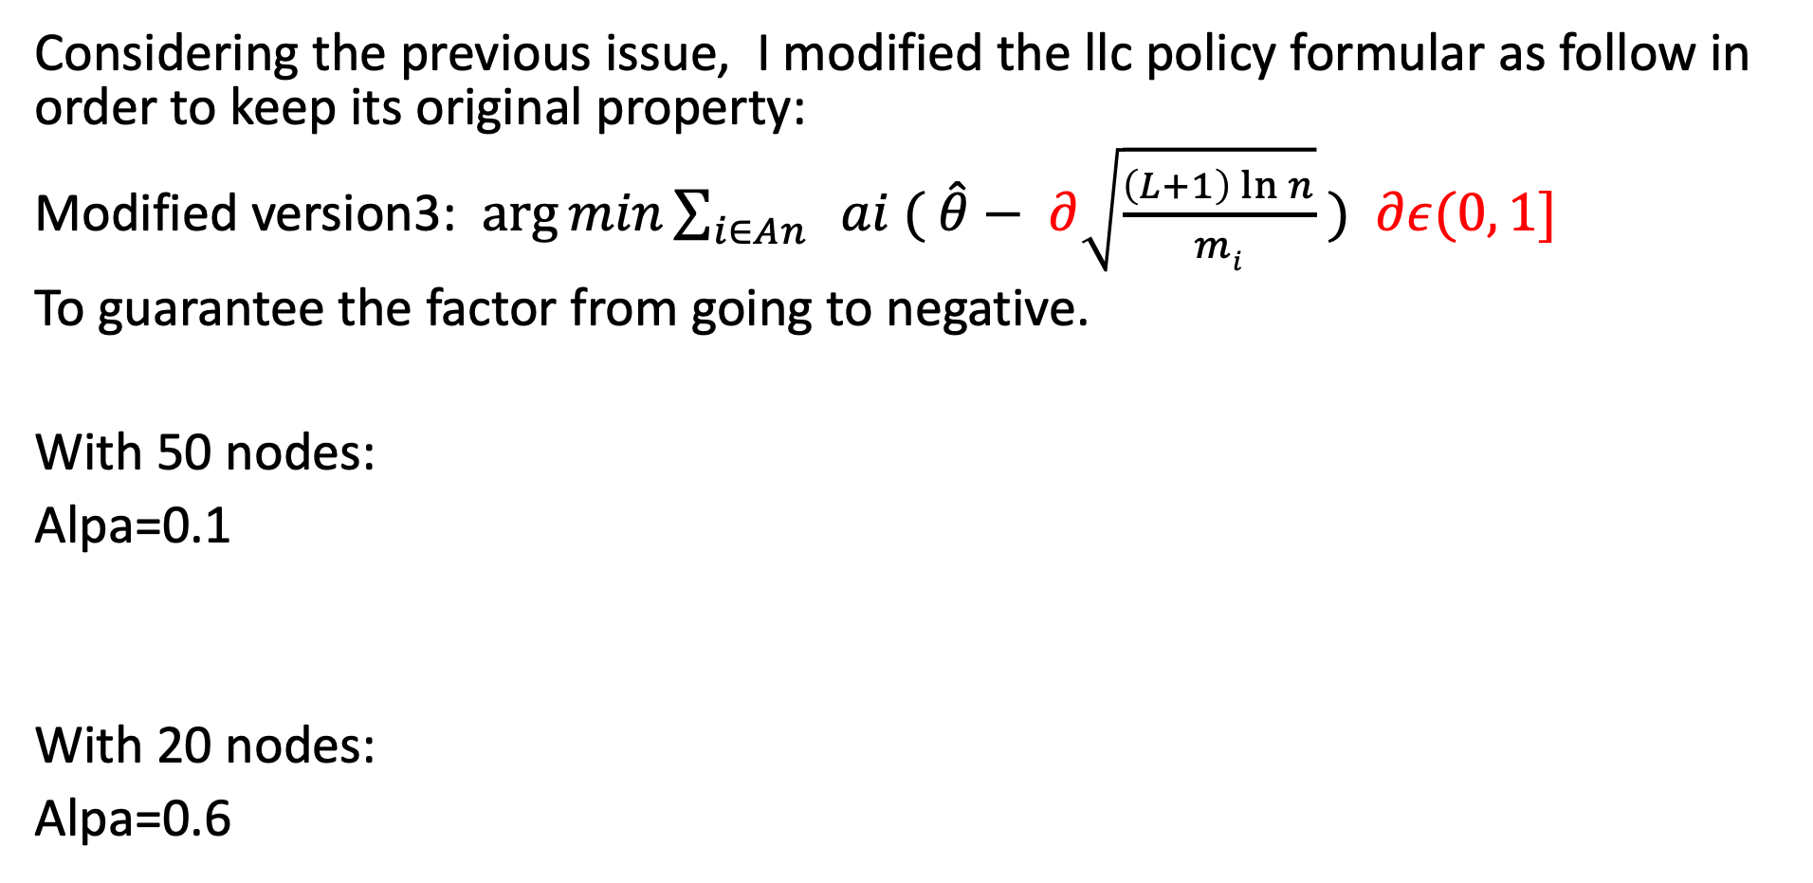
Considering the previous issue, I modified the llc policy formular as follow in order to keep its original property:
Modified version3: $\arg{min\sum_{i∈An}{ ai ( \hat{θ}− ∂\sqrt{\frac{\left(L+1\right)\ln{n}}{mi}}}} )$ $∂ε(0, 1]$
To guarantee the factor from going to negative.
With 50 nodes:
Alpa=0.1
With 20 nodes:
Alpa=0.6

Slide 17
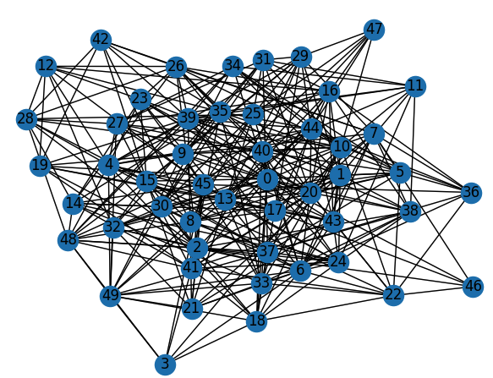
Multi-monitors version:
Goal: try to find the shortest path between ‘3’ and ’4.7’ with multiple monitors
Destination
Source

Slide 18
Multi-monitors version:
Goal: try to find the shortest path between ‘3’ and ’4.7’ with multiple monitors, for example, 4 monitors.
M2
M3
Destination
all_explored_edges=[]
For each iteration:
for monitor_pair in monitor_pair_list:
edge_list=LLC_policy(G, m1, m2,llc_factor )
all_explored_edges.append(edge_list)
all_explored_edges=set(all_explored_edges)
update_MBA_variable(all_explored_edges)
M4
Source
M1

Slide 19
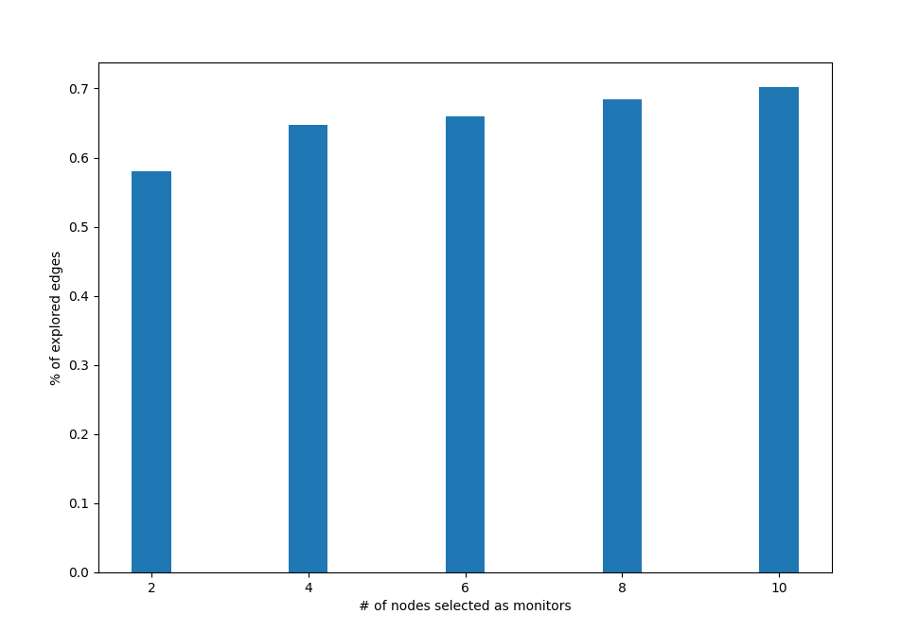
Results: the monitors are random selected

Slide 20
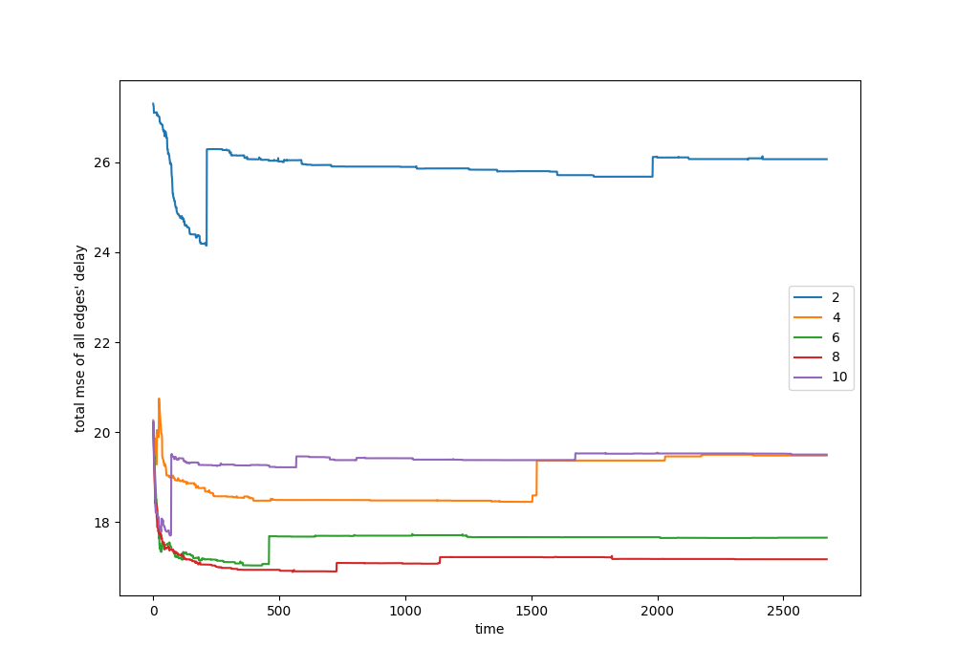
Results:

Slide 21
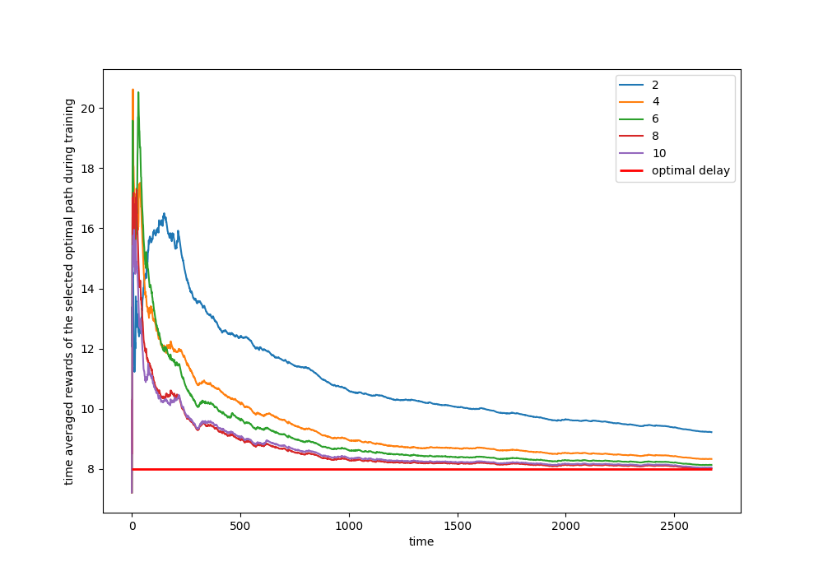
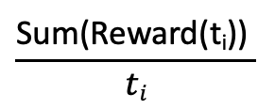
Results:
$$\frac{\text{Sum}\text{(}\text{Reward}\text{(}\text{ti}\text{)) }}{ti}$$

Slide 22
In progress: Trying to plot how the edge exploration varies with different number of monitors. [done] 1. Change a real topology [done]

Slide 23
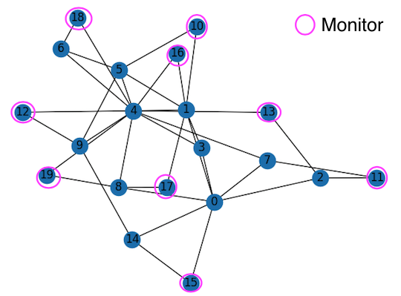
Barabasi topology with 20 nodes
All the nodes deployed with monitors are
end nodes with degree =2

Slide 24
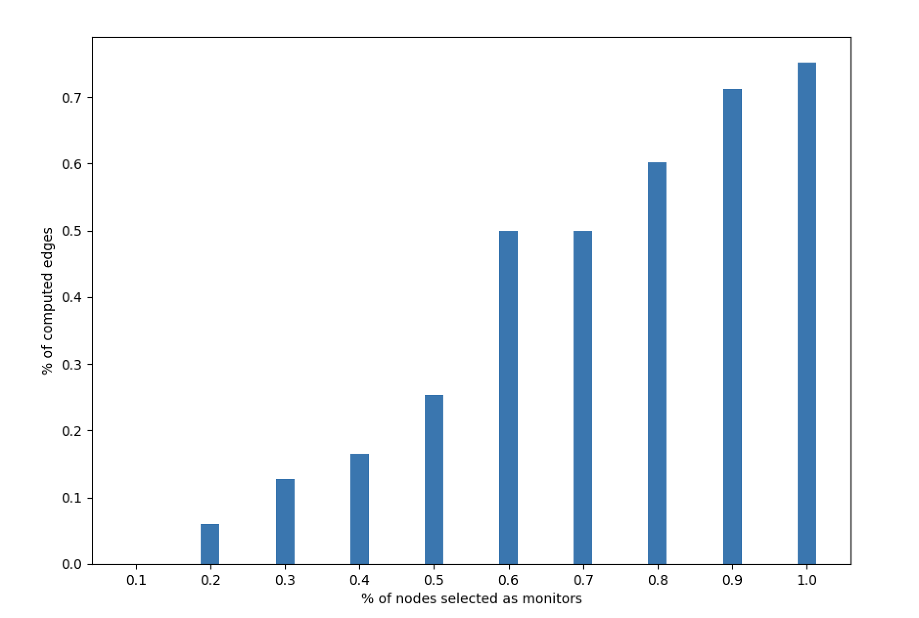
Edge computation rate with increasing monitors

Slide 25
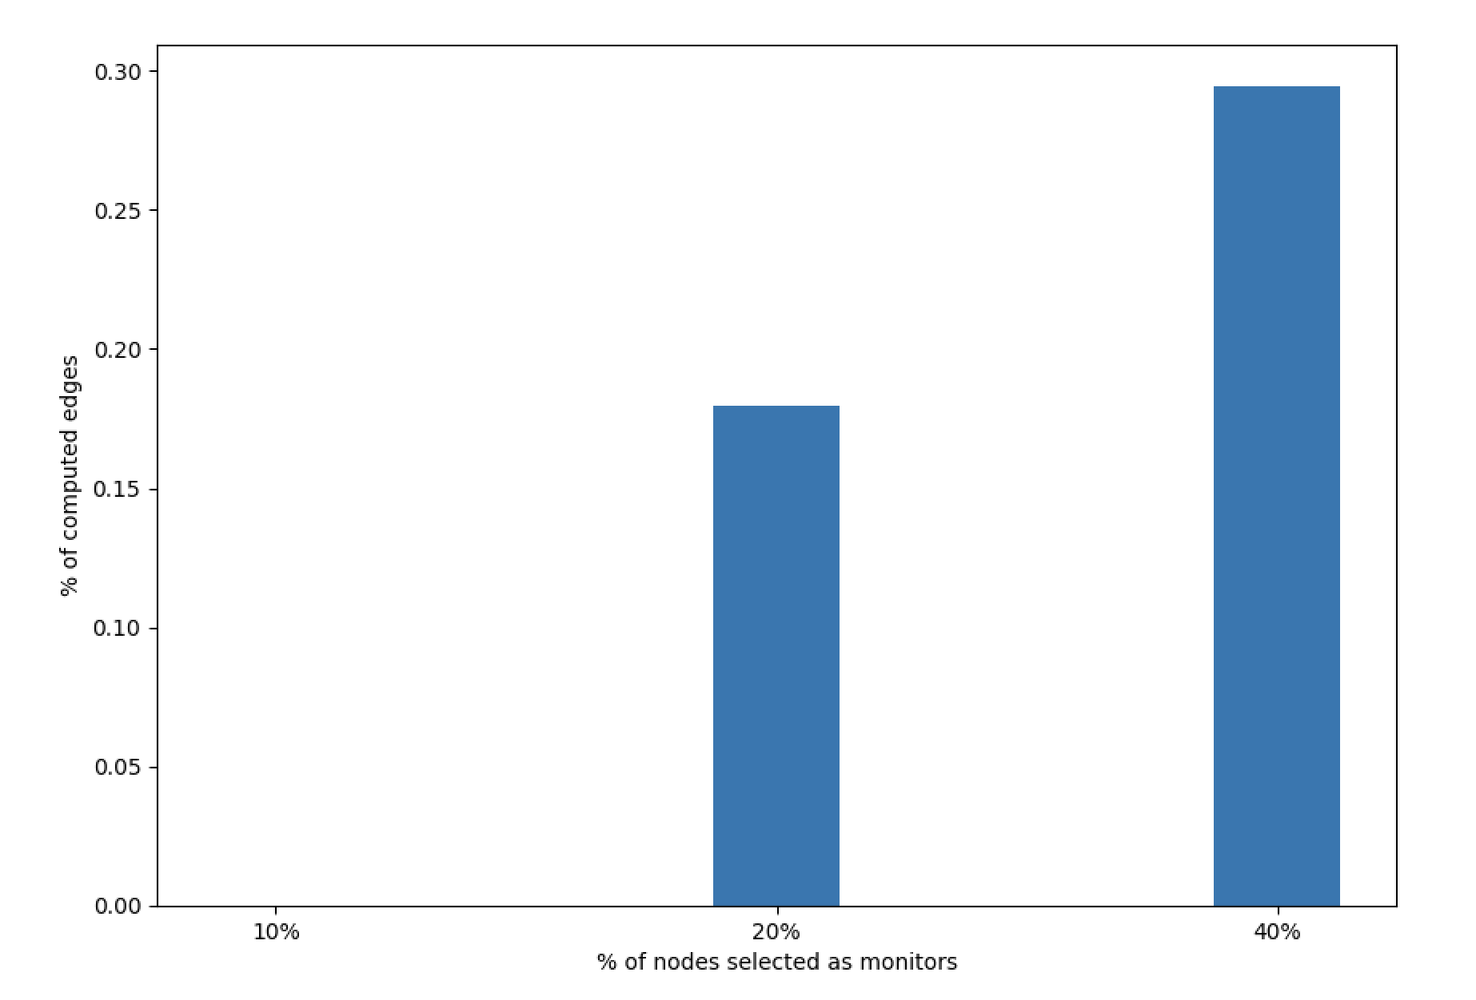
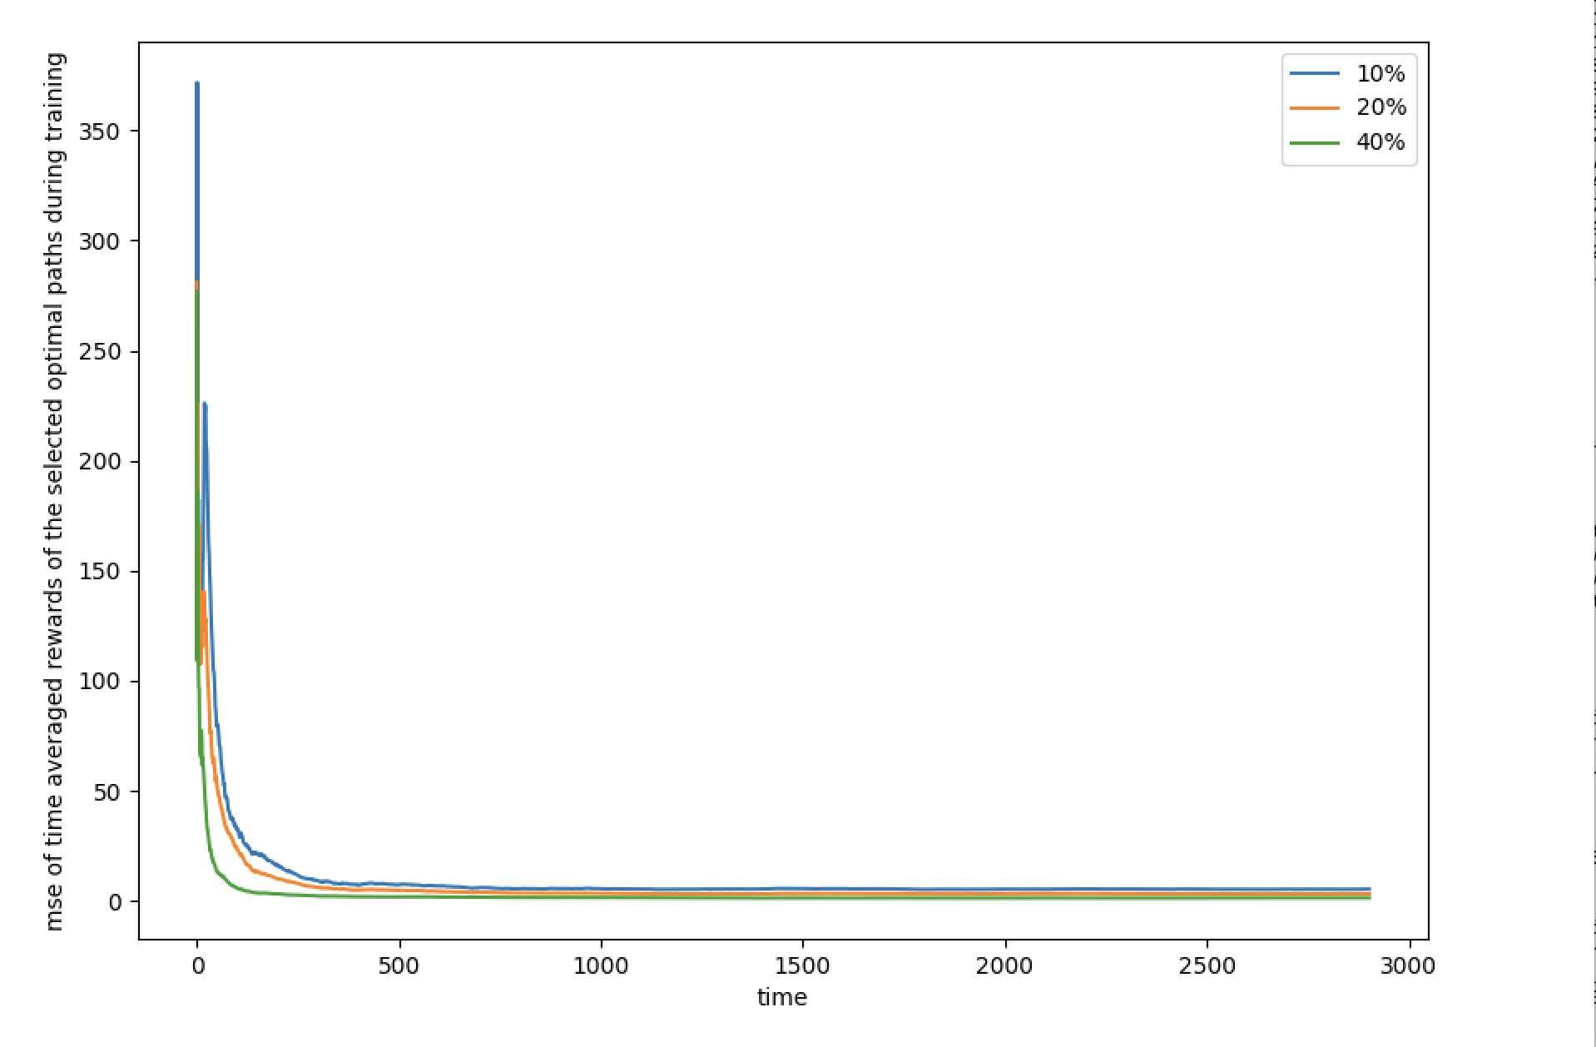
Barabasi: 50 nodes, 96 links

Slide 26
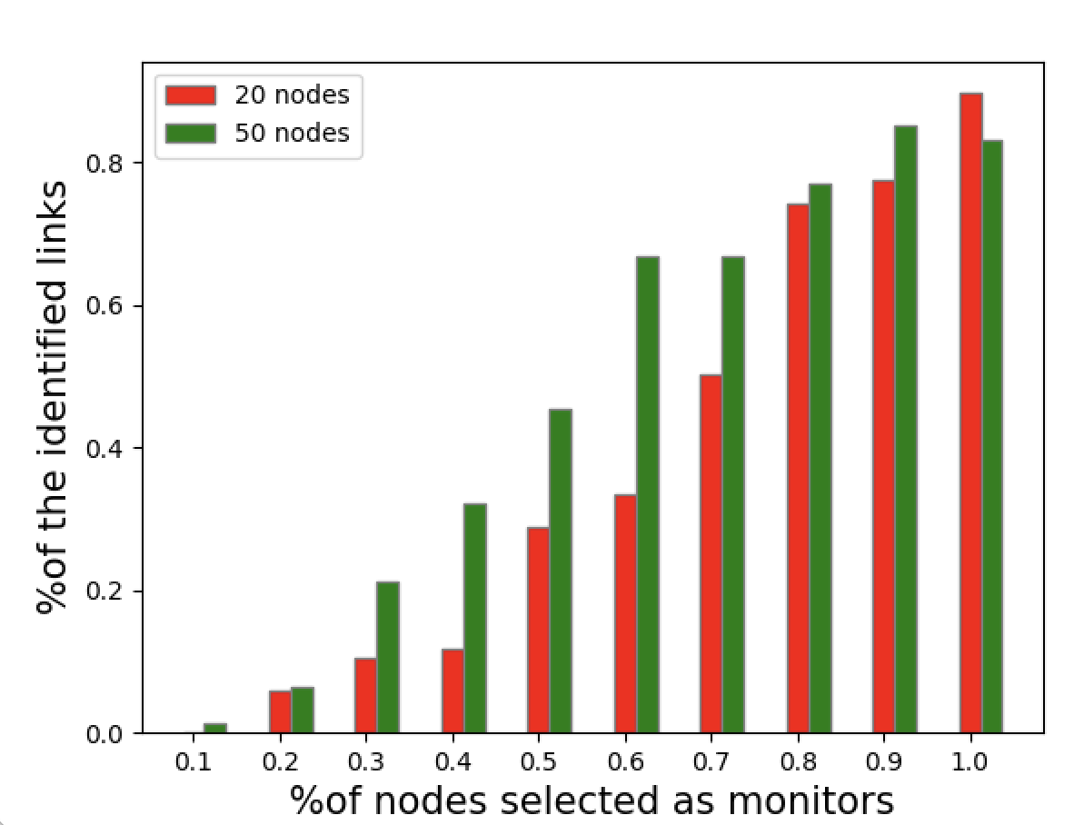
%of edge identified with different size Barabasi topology

Slide 27
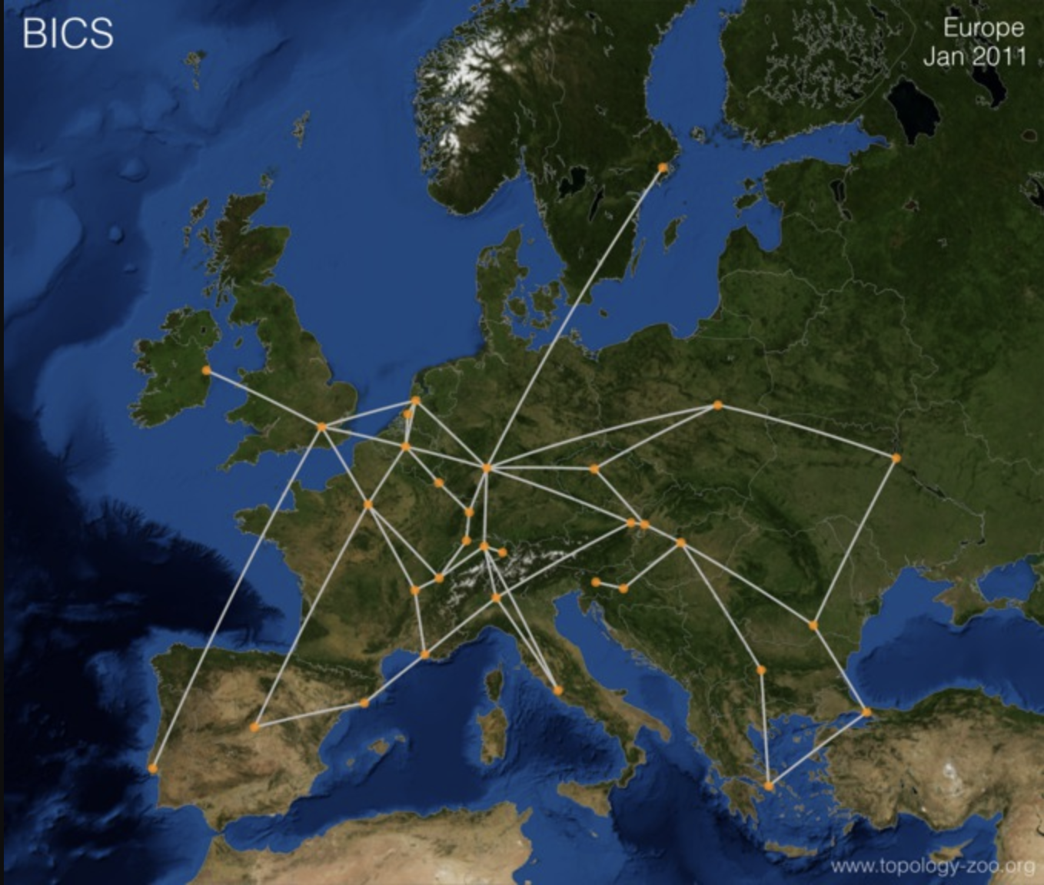
Real topology - The Internet Topology Zoo
Bics 33 nodes 48 links (doing the experiment of scalability of the identified links )

Slide 28
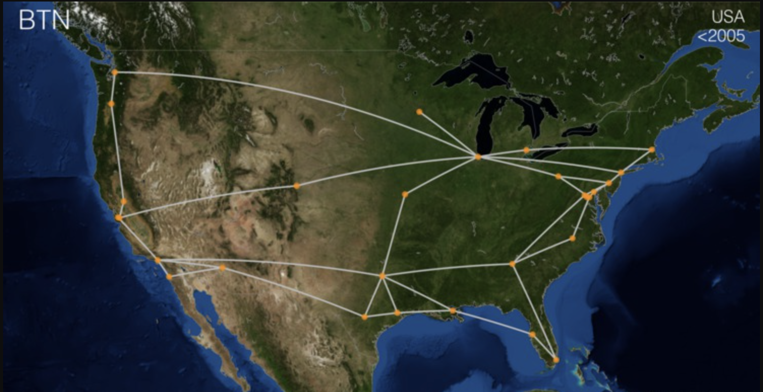
BTN – 53 nodes, 65 links (experiments is running for the scalability of the identified links)

Slide 29
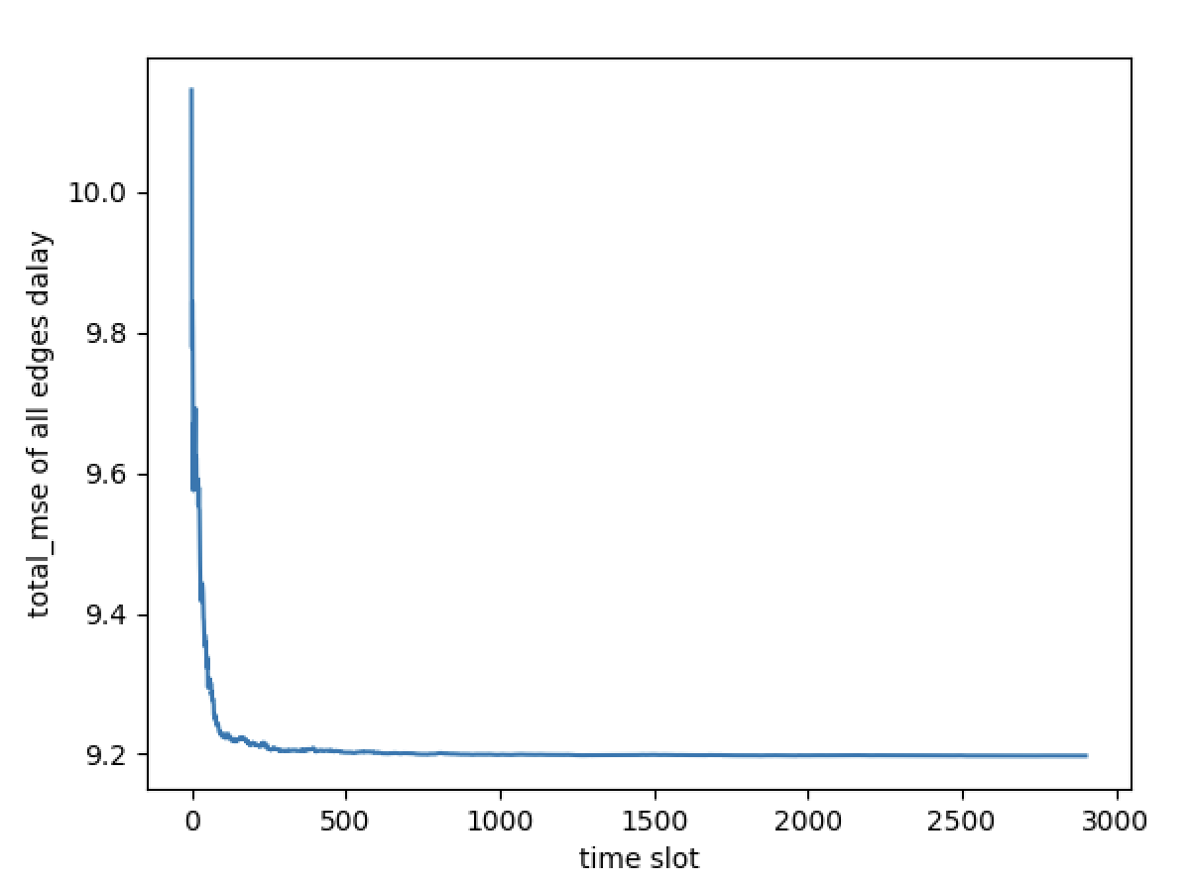
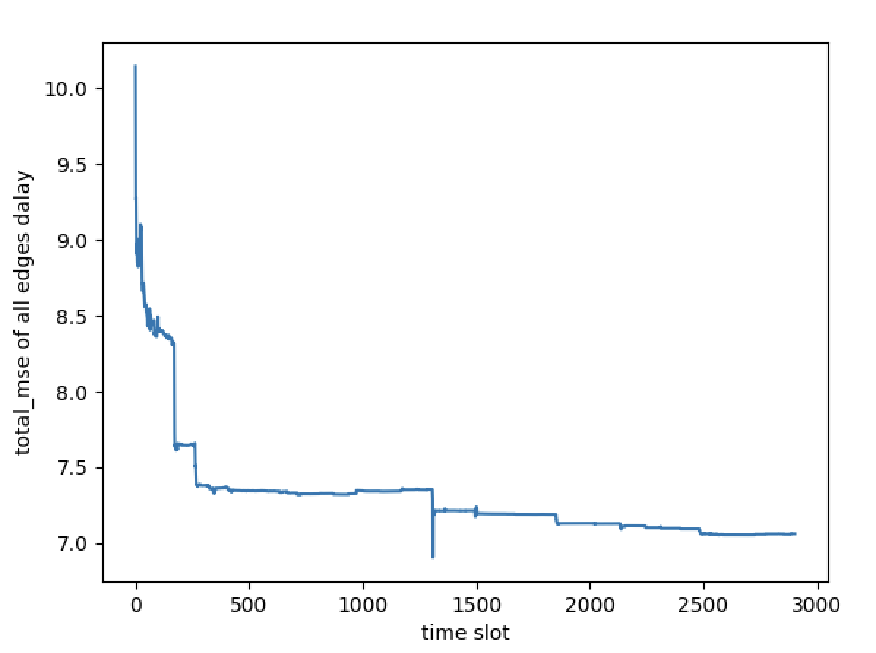
Barabasi 50nodes with 29% monitors (no NT, with original initialization)
Tol_MSE without MAB Tol_MSE with MAB

Slide 30
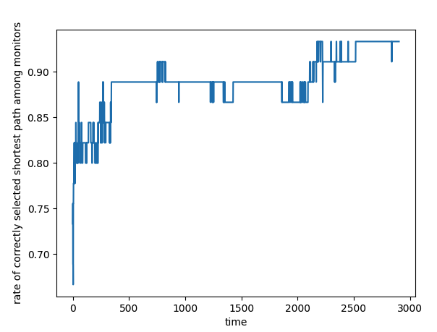
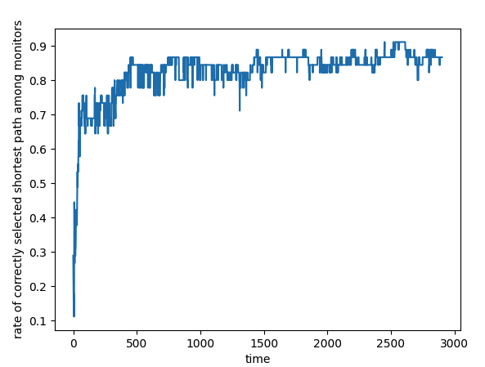
Rate of the correct selected shortest path
without MAB with MAB

Slide 31
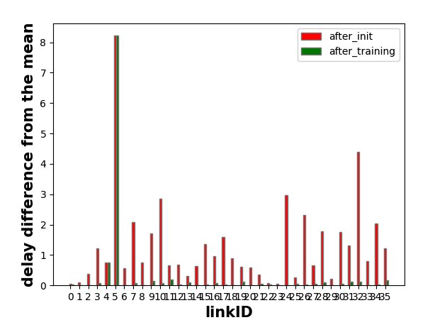
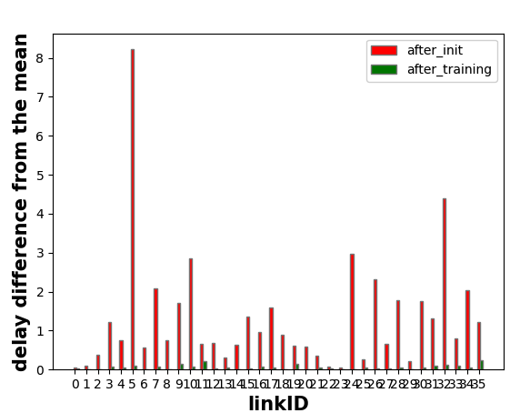
Delay difference of the optimal path from mean after initialization and after training
without MAB with MAB

Slide 32
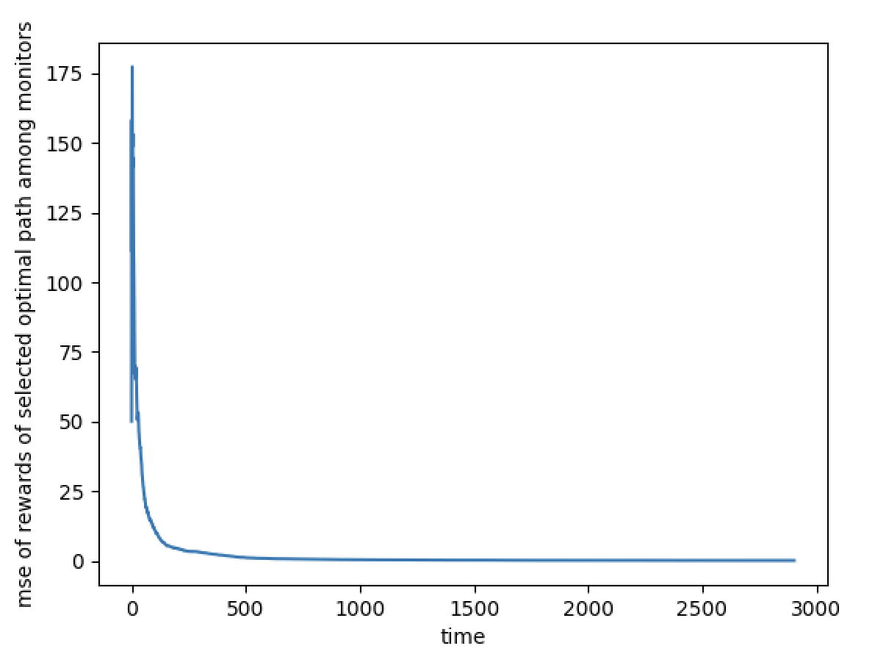
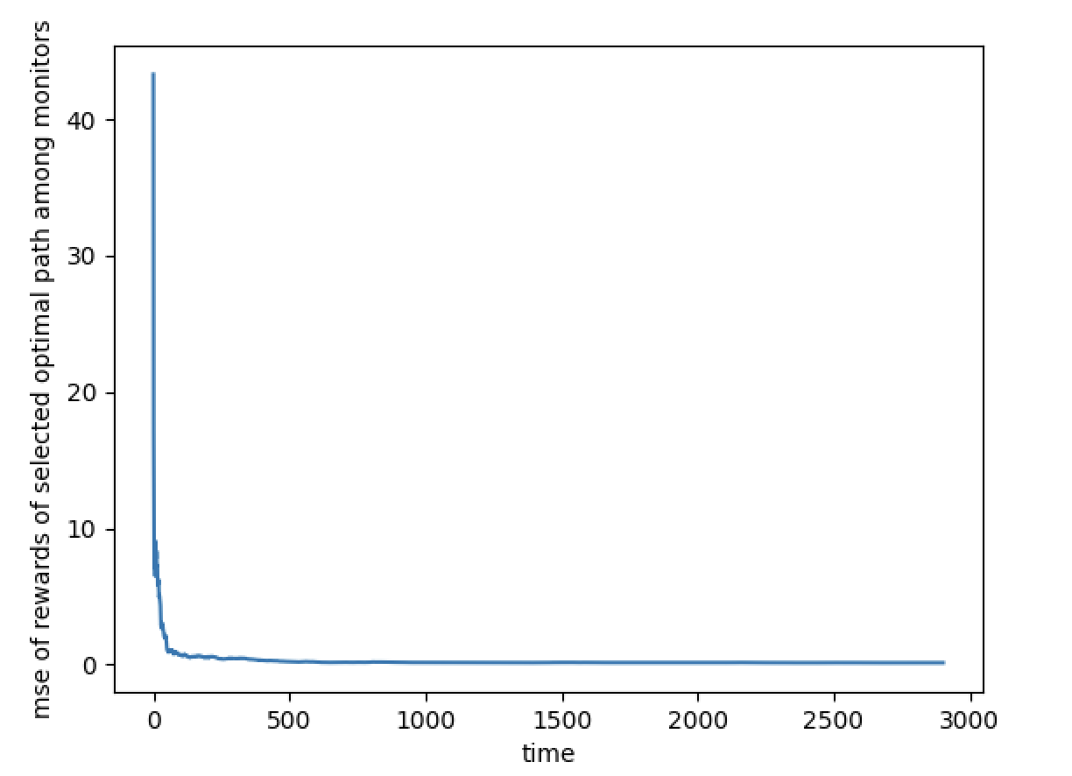
Delay difference of the optimal path from mean after initialization and after training
without MAB with MAB

Slide 33
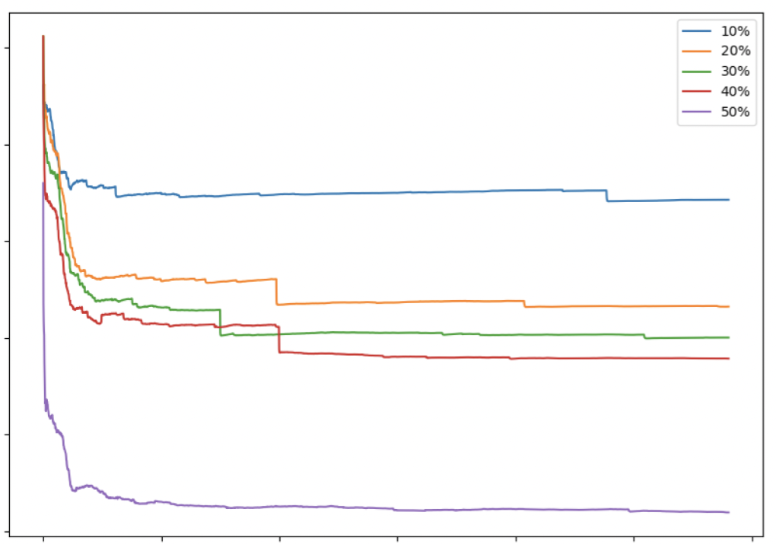
12
10%
20%
30%
40%
50%
+
10
X
8
MSE of all link’ delay during learning
+
6
+
+
+
+
4
X
X
X
X
X
2
0
500
1000
1500
2000
2500
3000
learning time

Slide 34
12
10
8
MSE of all link’ delay during learning
6
4
2
0
500
1000
1500
2000
2500
3000
learning time

